Slide 1
Math 769: Statistical Learning

Slide 2
What is Linear Regression?
Shahrzad Jamshidi, PhD

Slide 3
Last Time
In module 1, we discussed the elements of the statistical learning problem:
The dataset
The model
The inference
We also discussed various considerations needed to define a model that will allow for good inference.
We concluded with a formal treatment of the problem and saw that we need to consider the average loss pointwise with the dataset.

Slide 4
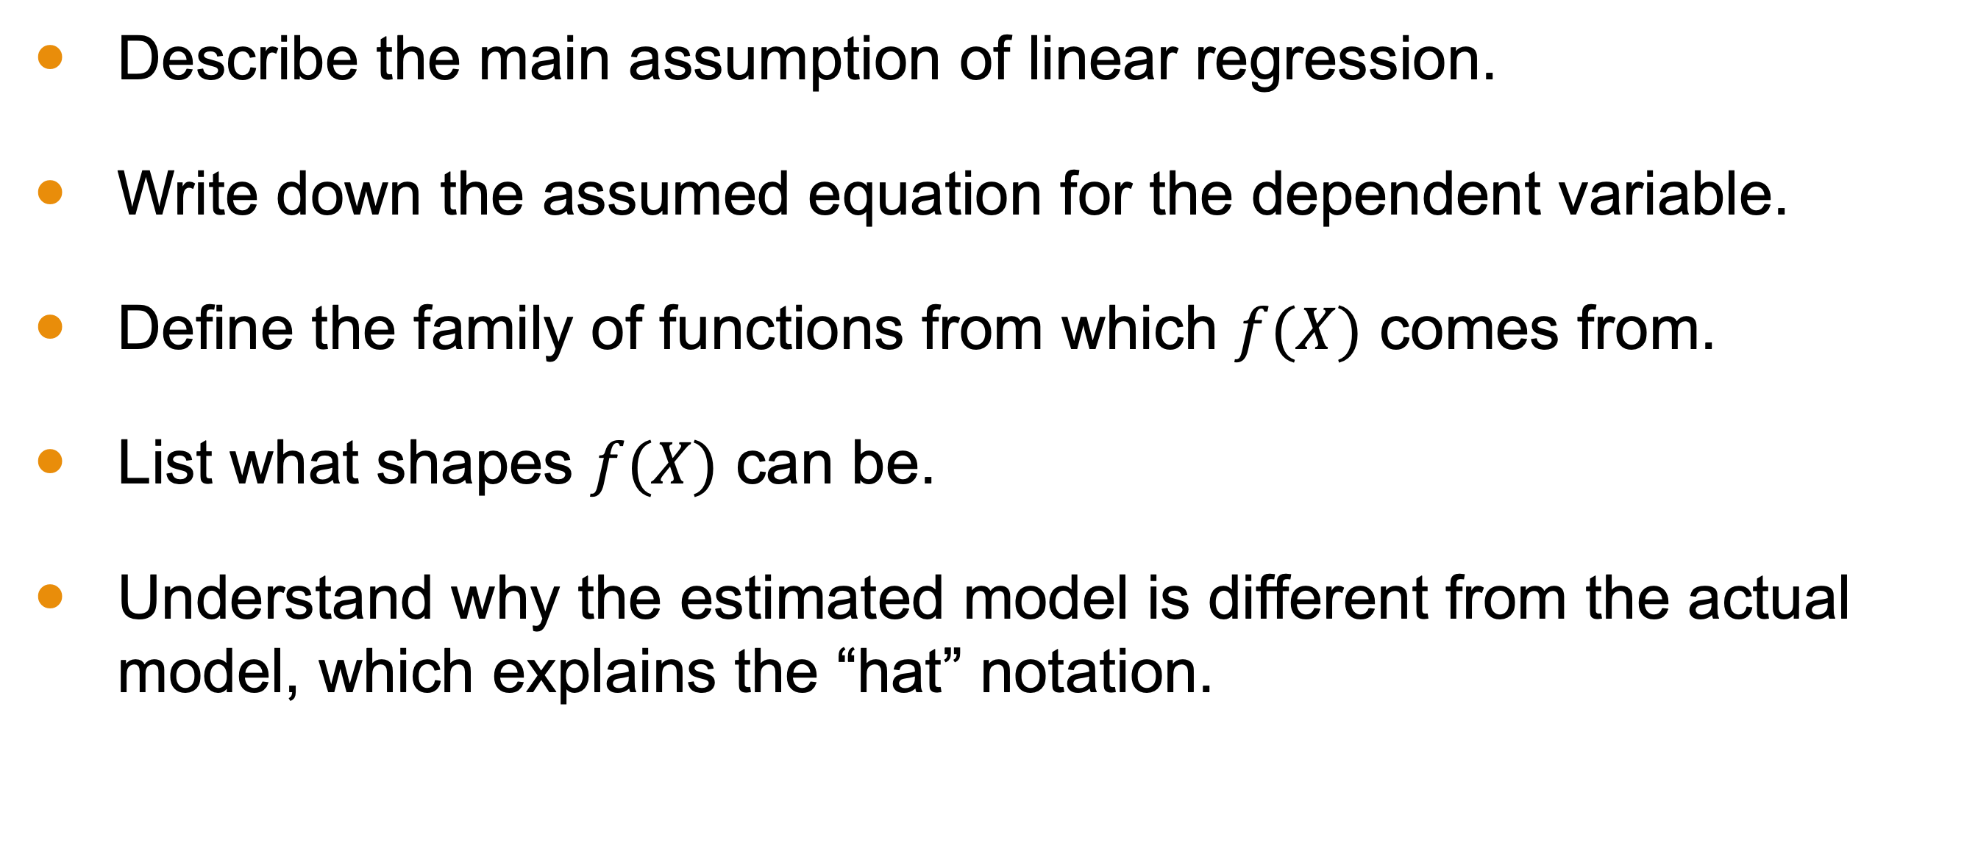
Objectives for this Lesson
Describe the main assumption of linear regression.
Write down the assumed equation for the dependent variable.
Define the family of functions from which $f(X)$ comes from.
List what shapes $f(X)$ can be.
Understand why the estimated model is different from the actual model, which explains the “hat” notation.

Slide 5
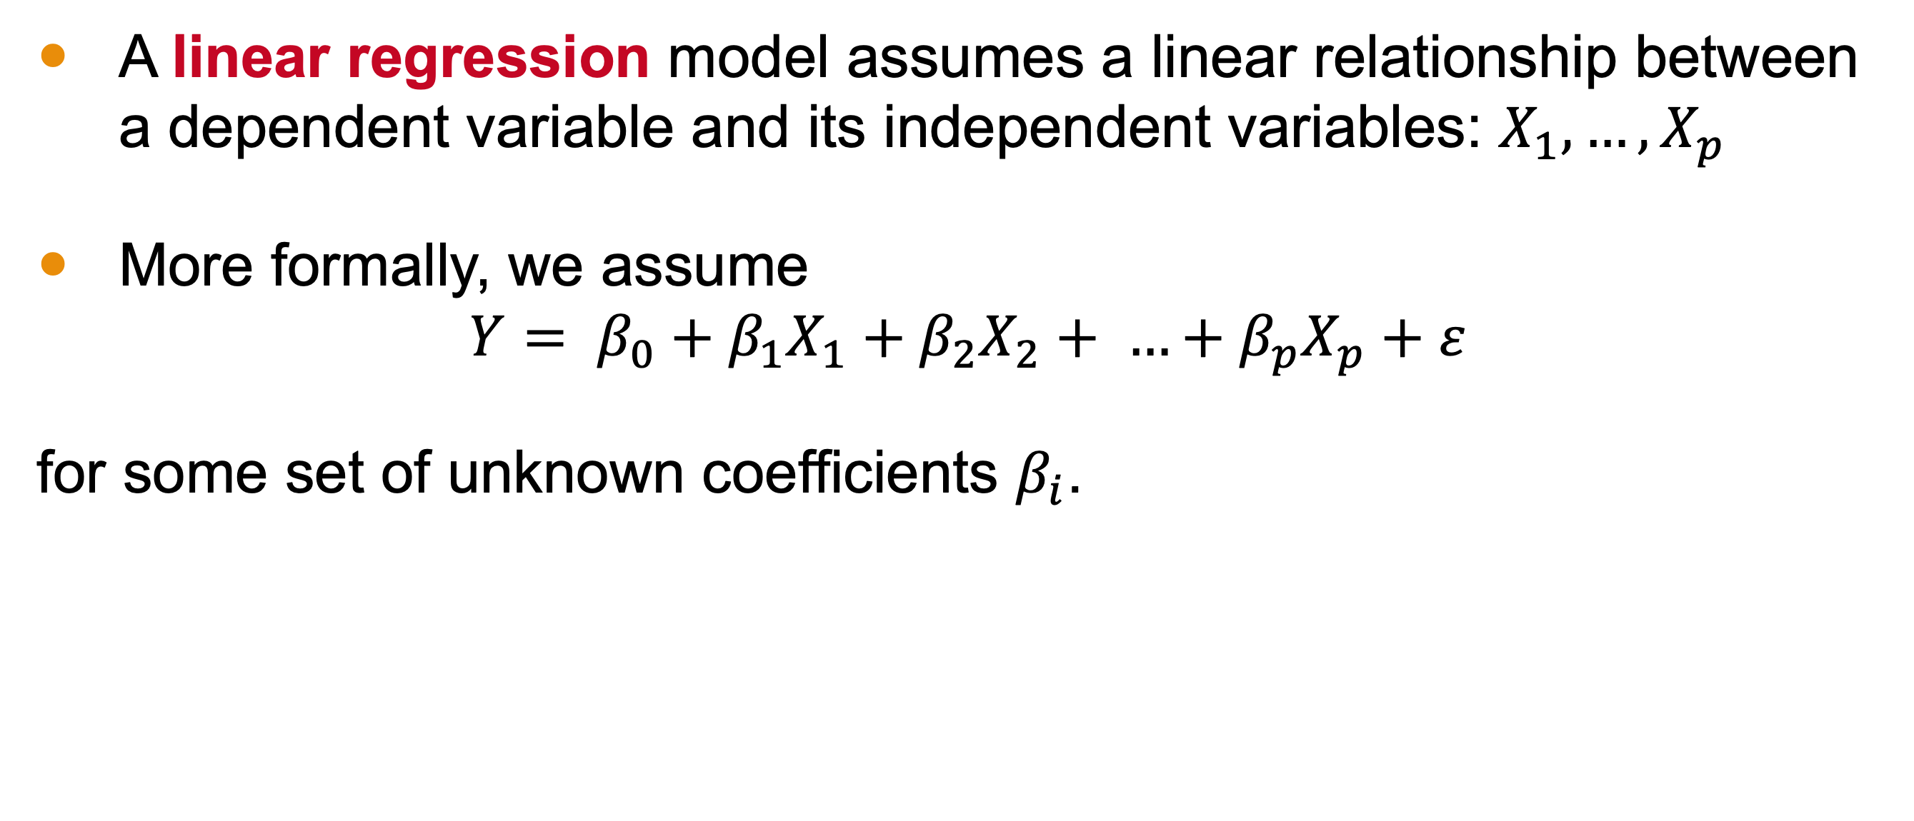
Linear Regression Assumption
A linear regression model assumes a linear relationship between a dependent variable and its independent variables: $X_{1},…,X_{p}$
More formally, we assume
$$Y= β_{0}+β_{1}X_{1}+β_{2}X_{2}+ …+β_{p}X_{p}+ε$$
for some set of unknown coefficients $β_{i}$.

Slide 6
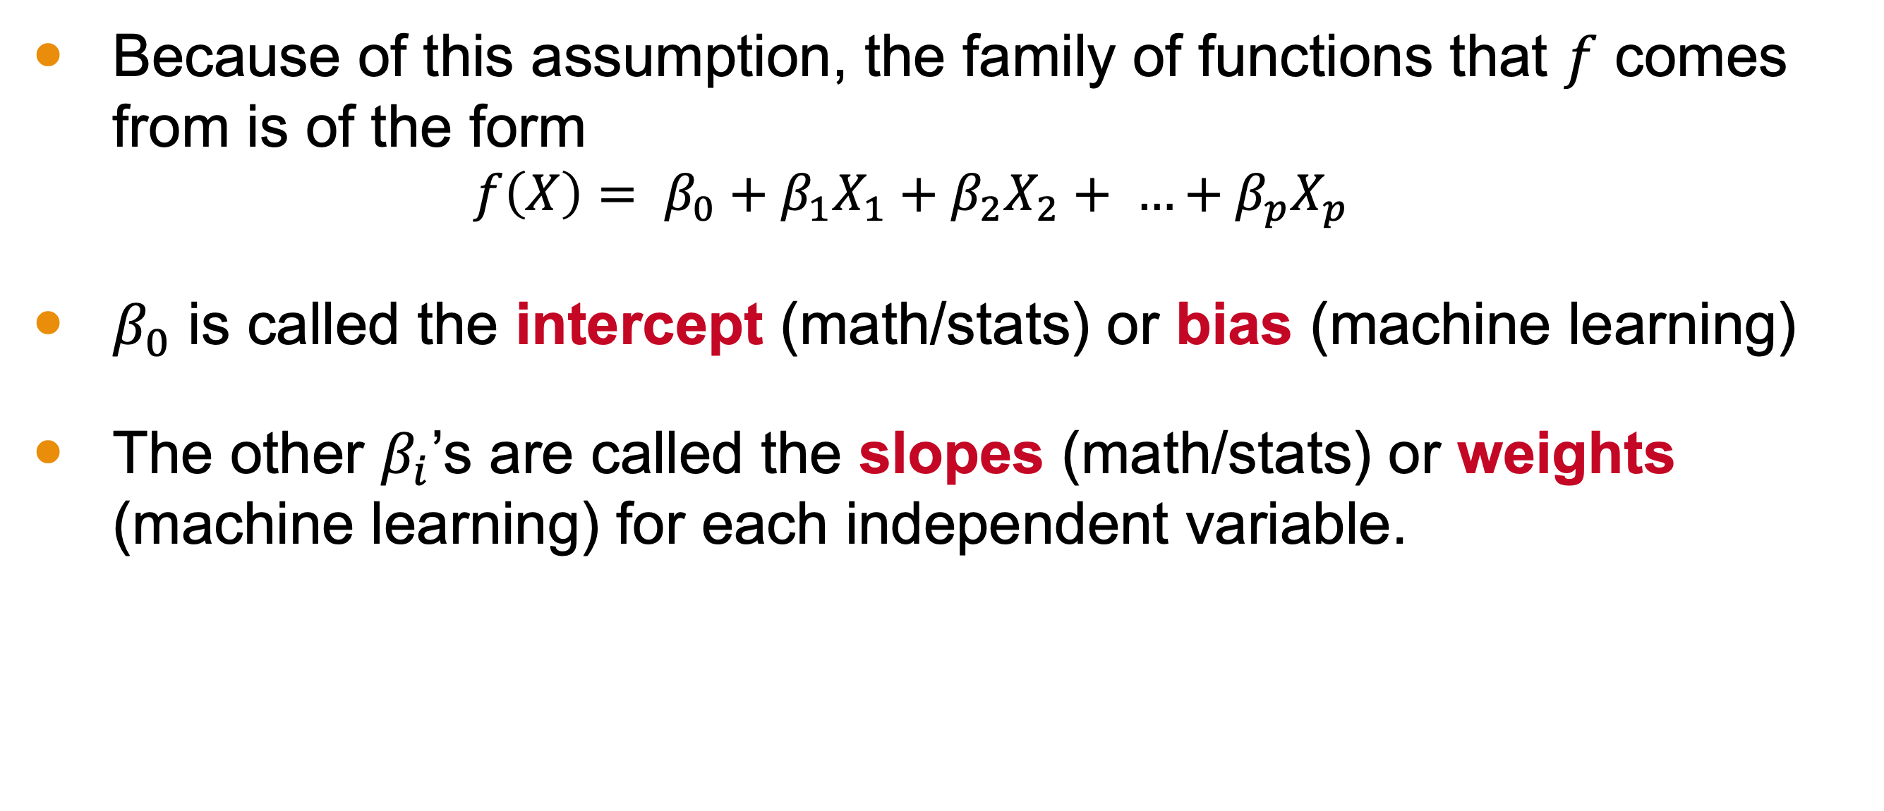
Linear Regression Model
Because of this assumption, the family of functions that $f$ comes from is of the form
$$f\left(X\right)= β_{0}+β_{1}X_{1}+β_{2}X_{2}+ …+β_{p}X_{p}$$
$β_{0}$ is called the intercept (math/stats) or bias (machine learning)
The other $β_{i}$’s are called the slopes (math/stats) or weights (machine learning) for each independent variable.

Slide 7
Example 1: Optional Hw and Midterm
Student | Optional Hw Completed | Midterm Grade
Ahmed | 0 | 12
Javier | 6 | 100
Mei Ling | 4 | 79
Priya | 1 | 33
Malik | 5 | 98
Sofia | 0 | 17
Yuri | 6 | 97
Aiden | 3 | 61
Ingrid | 5 | 95
Notes:
In our introduction, we saw an example of linear regression. Here, there is only one independent variable: the number of optional homework assignments completed (P=1). The midterm score is the dependent variable.

Slide 8
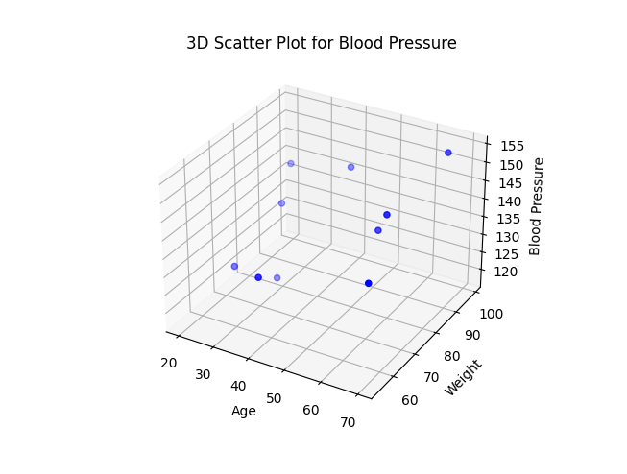
Example 2: Estimating Blood Pressure
Age | Weight | BP
64 | 72 | 149
67 | 96 | 154
20 | 99 | 137
23 | 70 | 124
23 | 90 | 131
59 | 77 | 141
29 | 79 | 118
39 | 97 | 142
41 | 54 | 136
70 | 54 | 142
Notes:
Here is another example. There are two independent variables, age and weight (so P = 2), and one dependent variable, blood pressure (abbreviated as BP).

Slide 9
What shape will the linear model take?

Slide 10
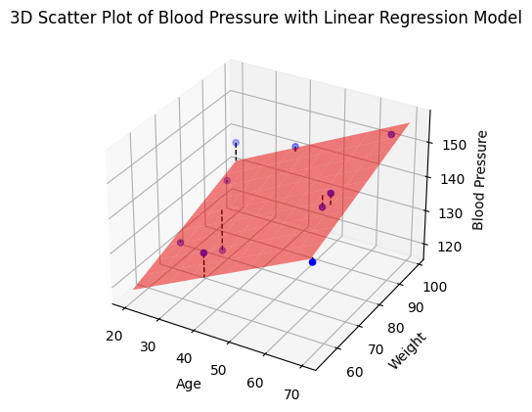
Estimating Blood Pressure
Age | Weight | BP
64 | 72 | 149
67 | 96 | 154
20 | 99 | 137
23 | 70 | 124
23 | 90 | 131
59 | 77 | 141
29 | 79 | 118
39 | 97 | 142
41 | 54 | 136
70 | 54 | 142

Slide 11
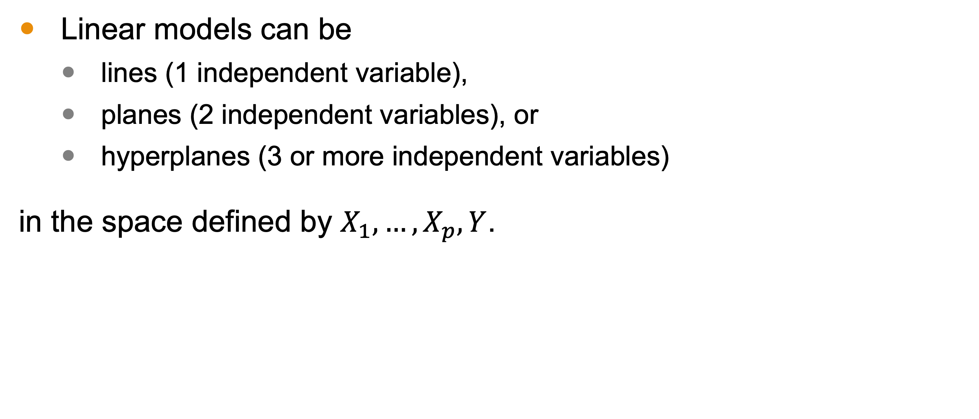
Linear Models Geometrically
Linear models can be
lines (1 independent variable),
planes (2 independent variables), or
hyperplanes (3 or more independent variables)
in the space defined by $X_{1},…,X_{p},Y$.

Slide 12
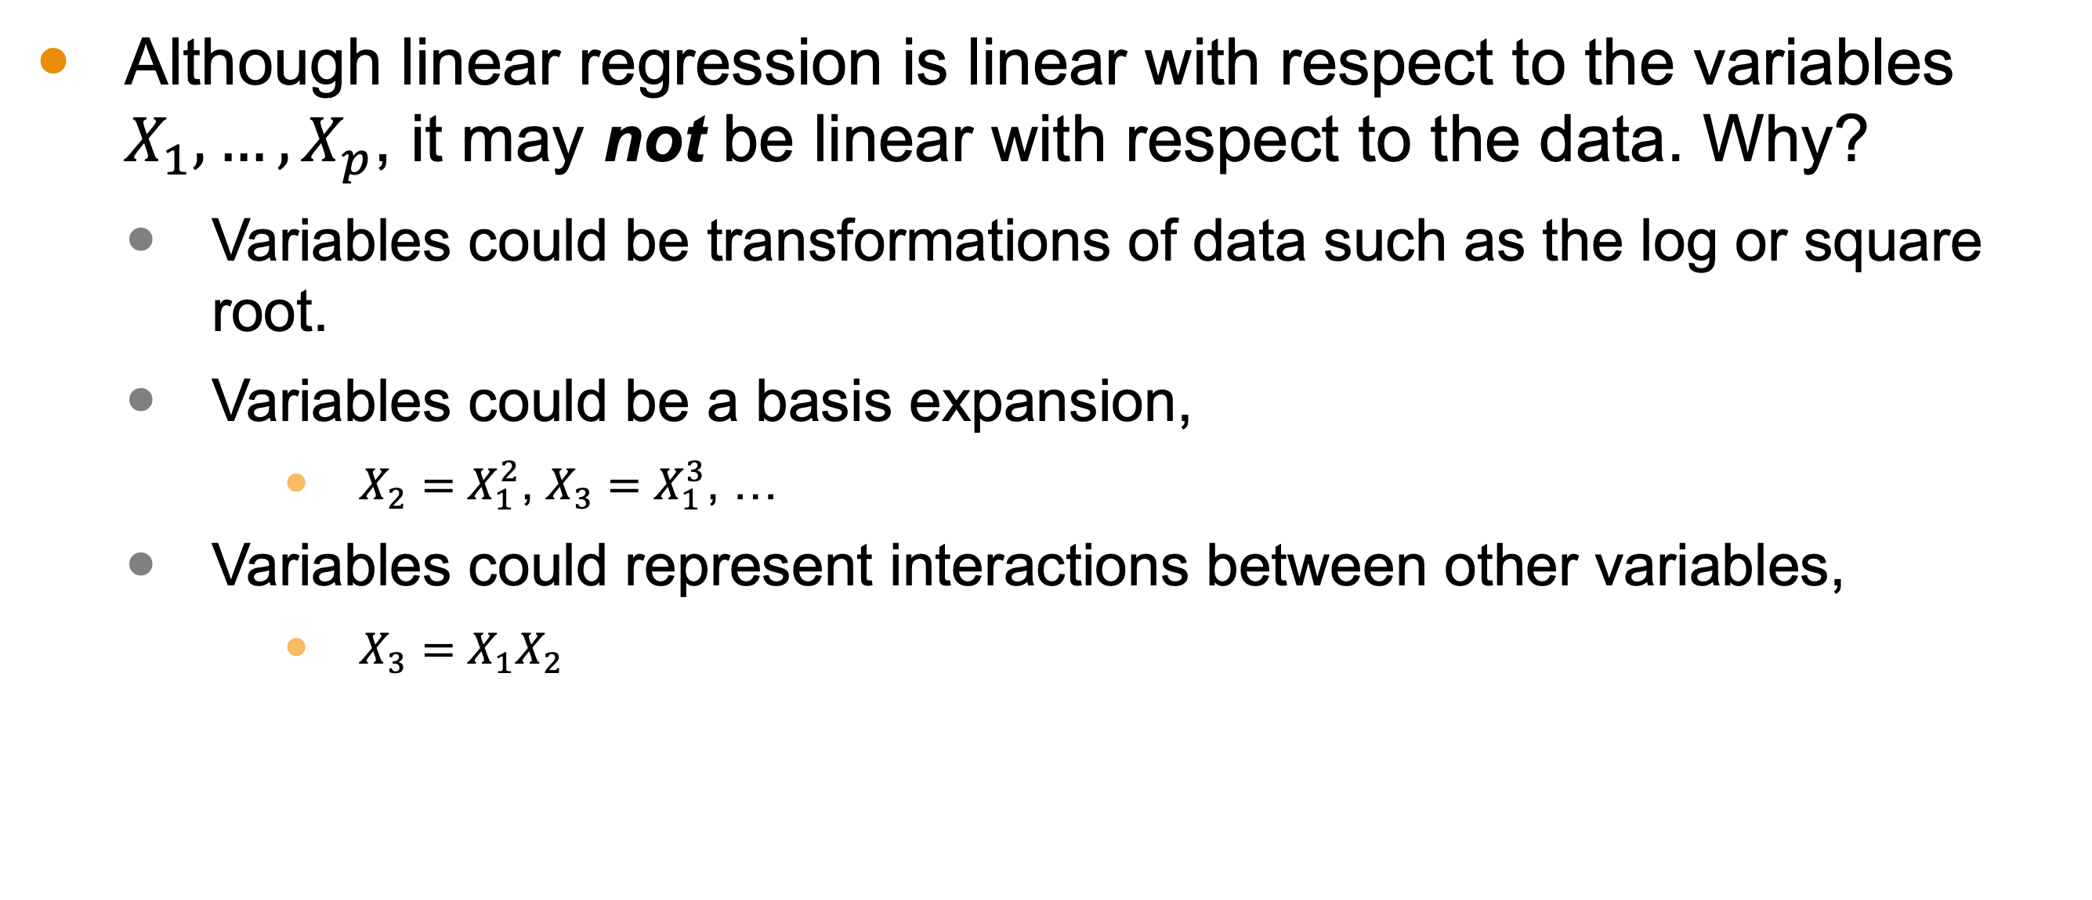
Remark on Geometry
Although linear regression is linear with respect to the variables $X_{1},…,X_{p}$, it may not be linear with respect to the data. Why?
Variables could be transformations of data such as the log or square root.
Variables could be a basis expansion,
$X_{2}=X_{1}^{2}$, $X_{3}=X_{1}^{3}$, …
Variables could represent interactions between other variables,
$X_{3}=X_{1}X_{2}$

Slide 13
Estimating Blood Pressure
Age | Weight | BP
64 | 72 | 149
67 | 96 | 154
20 | 99 | 137
23 | 70 | 124
23 | 90 | 131
59 | 77 | 141
29 | 79 | 118
39 | 97 | 142
41 | 54 | 136
70 | 54 | 142
Notes:
Notice that several of the points don’t fall directly on the model. The vertical lines indicating distance demonstrate an error

Slide 14
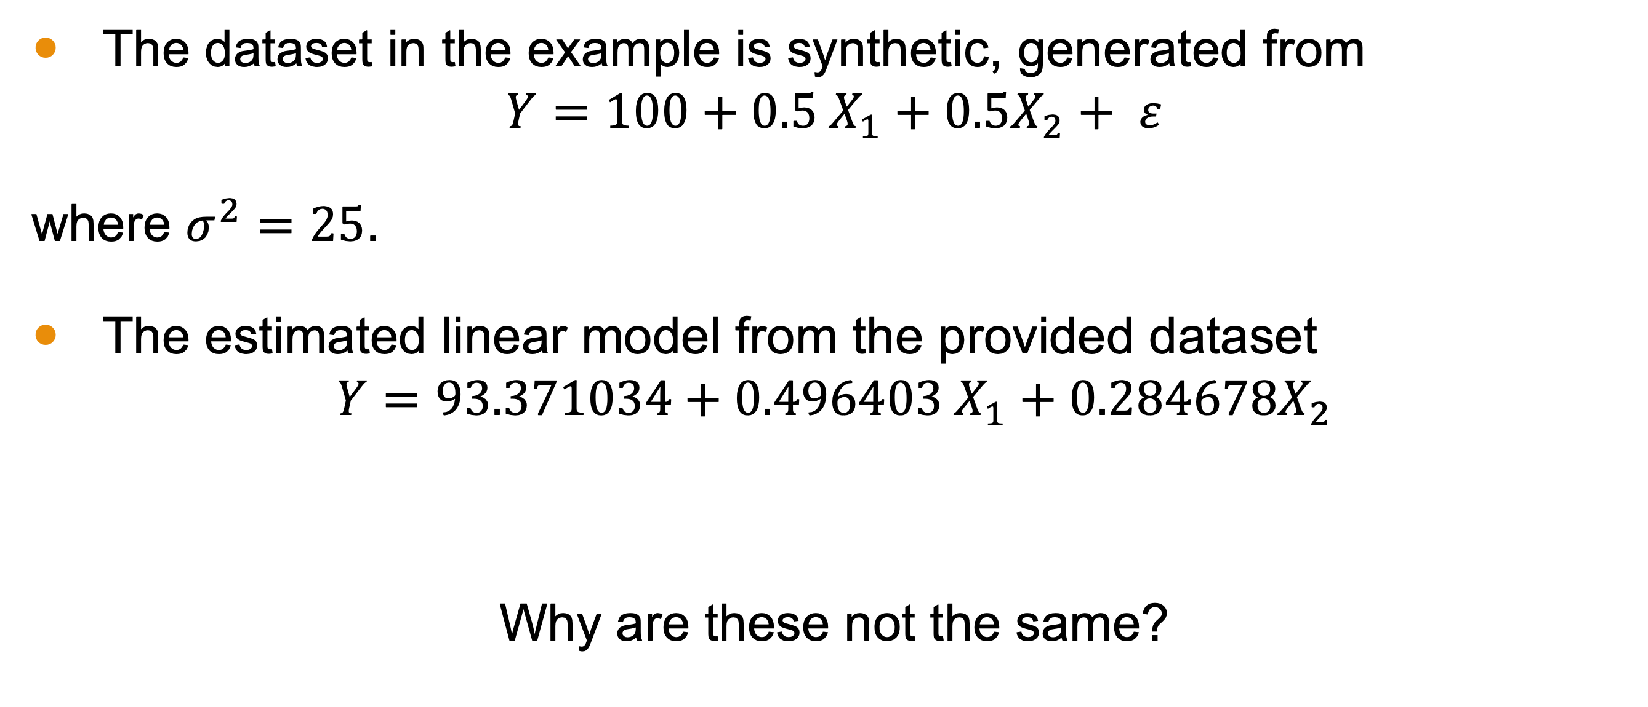
The True Versus the Estimated Model
The dataset in the example is synthetic, generated from
$$Y=100+0.5 X_{1}+0.5X_{2}+ ε$$
where $σ^{2}=25$.
The estimated linear model from the provided dataset
$$Y=93.371034+0.496403 X_{1}+0.284678X_{2}$$
Why are these not the same?

Slide 15
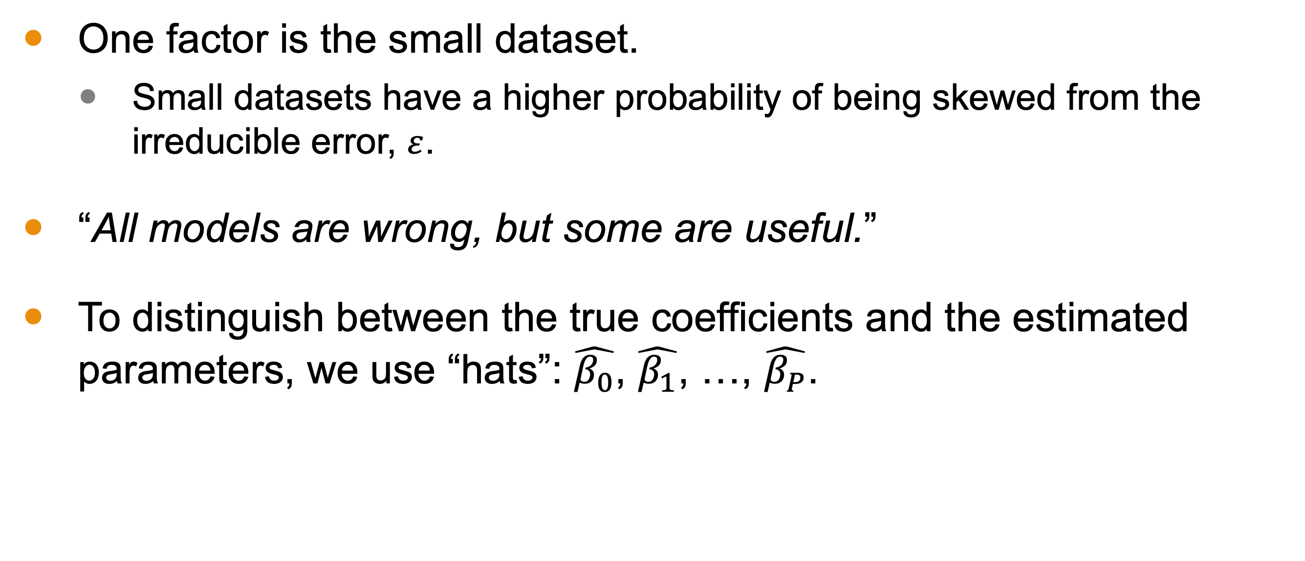
The True Versus the Estimated Model
One factor is the small dataset.
Small datasets have a higher probability of being skewed from the irreducible error, $ε$.
“All models are wrong, but some are useful.”
To distinguish between the true coefficients and the estimated parameters, we use “hats”: $\hat{β_{0}}$, $\hat{β_{1}}$, …, $\hat{β_{P}}$.
Notes:
This famous quote is attributed to George Box from 1976.
Whenever you see the hat notation, what’s being communicated is that this is an estimated value.

Slide 16


Estimated Versus Actual
$\hat{β_{0}}$ = $93.371034$
$\hat{β_{1}}$ = $0.496403$
$\hat{β_{2}}$ =$0.284678$
$β_{0}=100$
$β_{1}=0.5$
$β_{2}=0.5$

Slide 17
Estimated Versus Actual
$\hat{β_{0}}$ = $93.371034$
$\hat{β_{1}}$ = $0.496403$
$\hat{β_{2}}$ =$0.284678$
$β_{0}=100$
$β_{1}=0.5$
$β_{2}=0.5$
HIDDEN!
Notes:
In the real world, this information is hidden! If we knew it, we wounld’t bother doing all this computation.

Slide 18
Conclusion
Linear regression is an approach used when we fit a line, plane or hyperplane to a dataset.
We use this when we assume a linear relationship between the dependent variable and the independent variables.
Even if our assumption is right, our estimated model is likely incorrect. We use “hats” to differentiate the true values and the estimated ones.
In the next lesson, we go over how to perform linear regression.

